Slide 1
THE “INs AND OUTs” OF ALLEYS FOR THE CITY OF HOUSTON

Slide 2
CHAPTER 40-ARTICLE XV HOUSTON CODE OF ORDINANCES Ord: 99-379
Code of Ordinances 40-340 through 40-346
ALLEY
Access easement across the rear lot
Must connect to two public streets
PUBLIC ALLEY
Dedicated ROW-Platted (shown on recorded plats)
PRIVATE ACCESS (Residential Only)
PUBLIC ACCESS
Not all dedicated alley ROW has been accepted by City for Maintenance
PRIVATE ALLEY
Not Platted
Essentially a driveway on private property

Slide 3
PRIVATE ALLEY
Not platted
Private Access by Driveway
Connection to Public Street Only at Ends
Application for Access as a Driveway
Permit at 3300 Main Street, Traffic Section
Application and Driveway approach detail

Slide 4
PUBLIC ALLEY PRIVATE ACCESS (Residential)
IMPROVED
NON-IMPROVED
Asphalt
Concrete
Gravel/Shell (6 inch compacted min.)
V-section or culvert
Low Impact Design
Follow city design standard
12-ft width min. paving if ROW >15 feet
8-ft width min. paving if ROW <15 feet
Have not had any improvements
Drivable – no paving req.
Minor repairs – limited spot repairs 3’x3’ / block

Slide 5
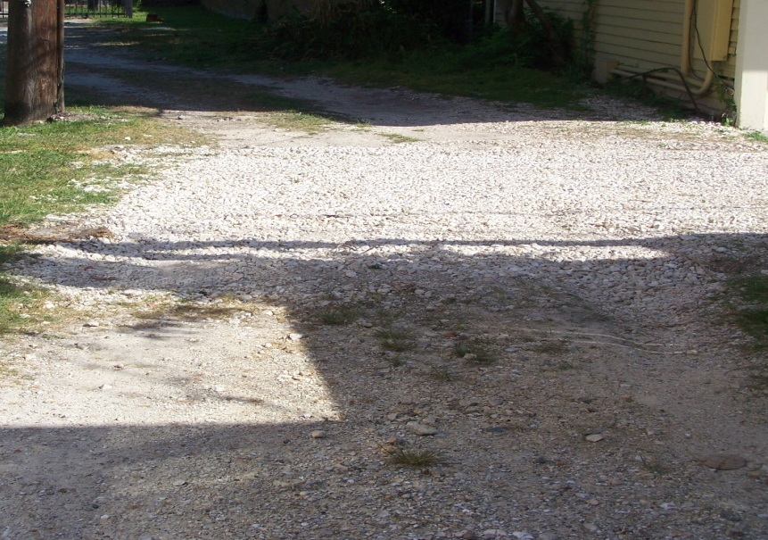
Spot Repair
Alley Improvement

Slide 6
PRIVATE ACCESS ALLEY Typical Design

Slide 7
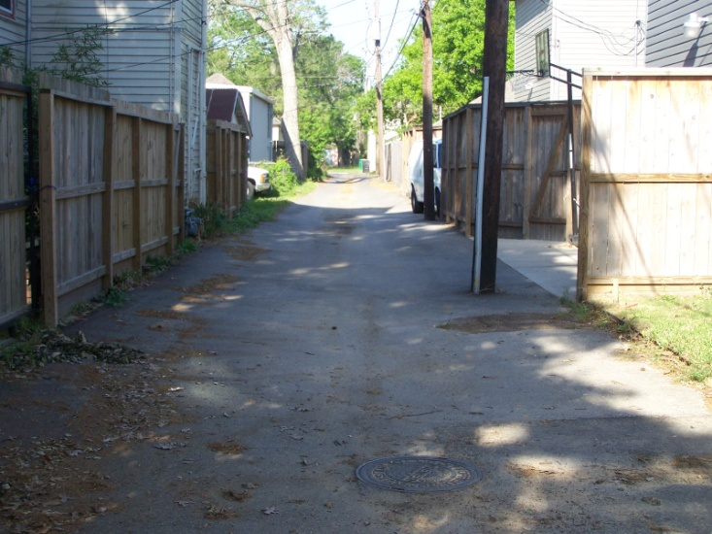
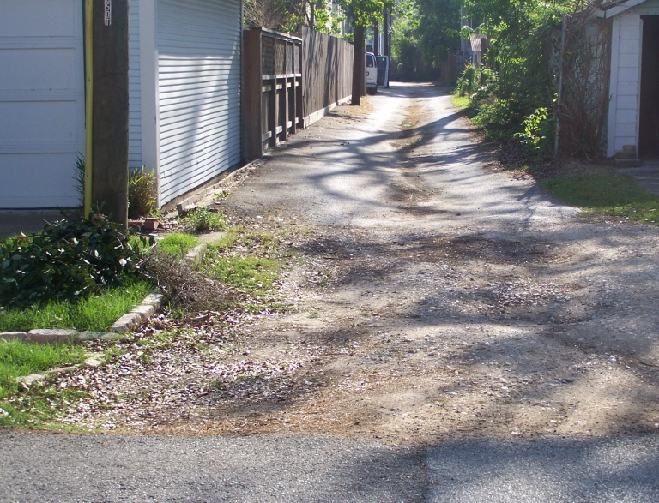
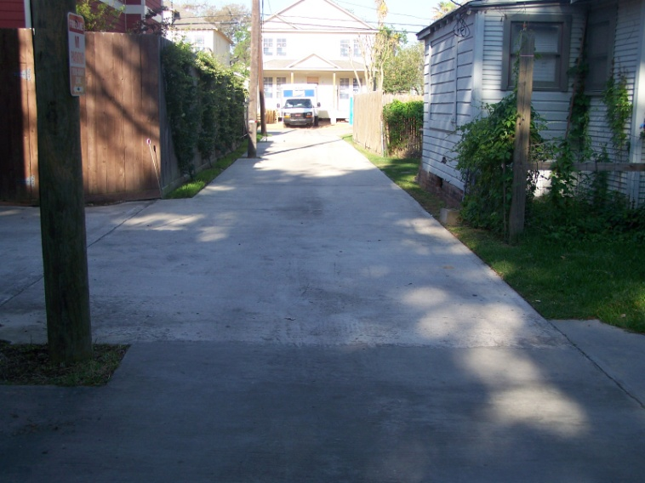

Slide 8
PUBLIC ALLEY PRIVATE ACCESS PERMITTING
3300 Main
STEP I - Plans
Site Plan (dimensioned)
Alley width
Garage Door set back from property line (20-ft min. clearance from garage to far side of alley)
10’ drivable surface beyond driveway for exiting
Pictures of existing alley
STEP II - Application
- 3300 Main, Traffic Section
Provide Plans and No
Objection Letter
Permits
Driveway
Sidewalk
No Objection Letter
Request to City Engineer’s Office—Attn: Richard Smith
Review = 2 weeks for verification of conditions (map or site visit)

Slide 9
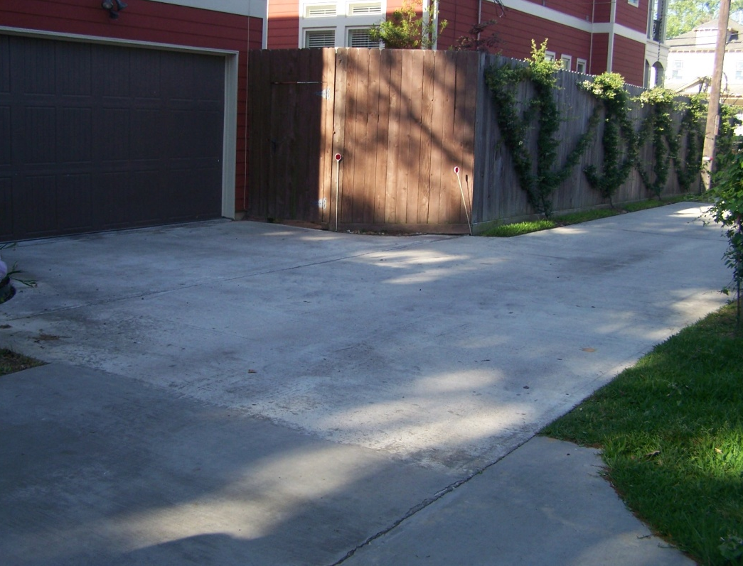
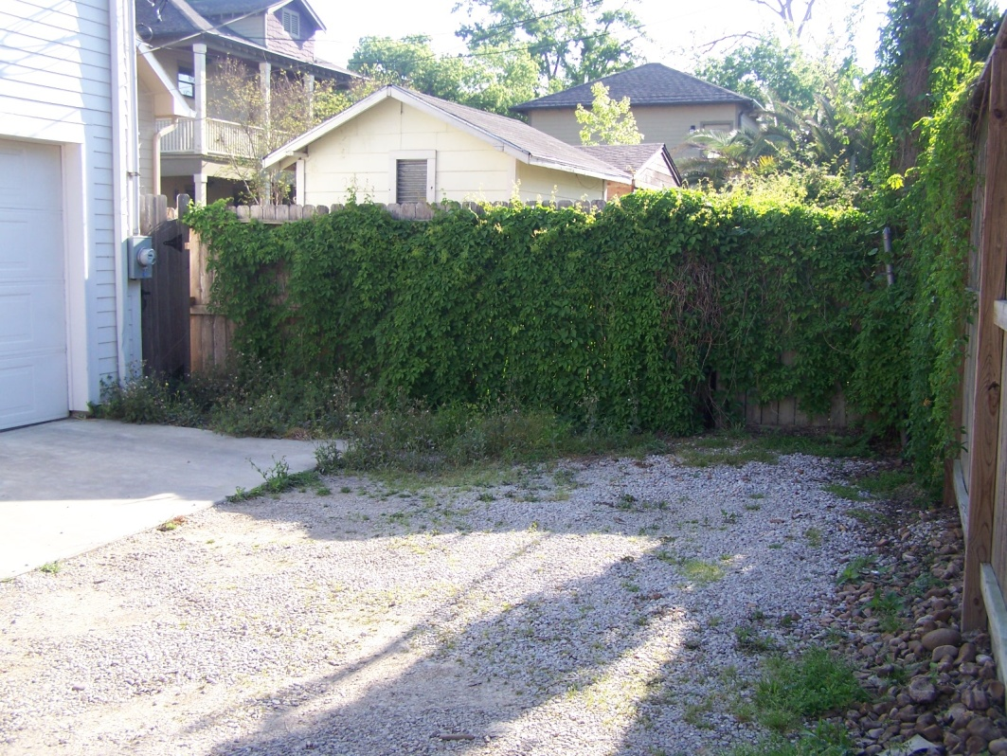
20-ft alley cross clearance
10-ft clear driving area beyond edge of driveway

Slide 10
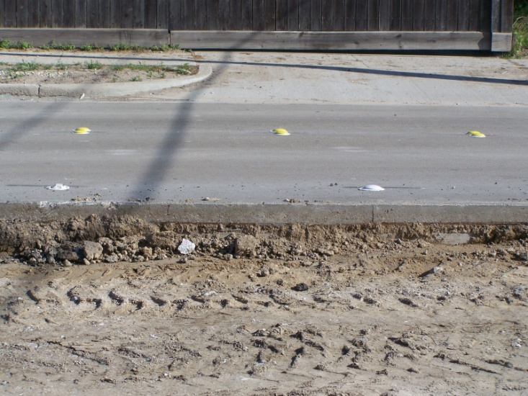
PUBLIC ALLEY PUBLIC ACCESS (Commercial)
Asphalt
Concrete
V-section or culvert drainage
Follow city design standard
V Section Typical Design

Slide 11
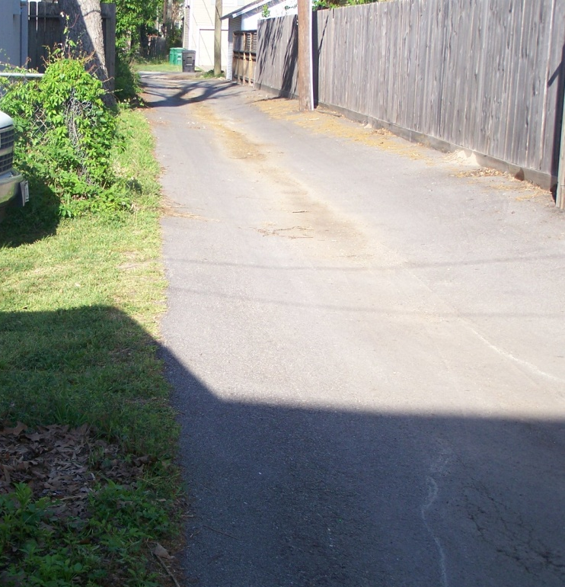
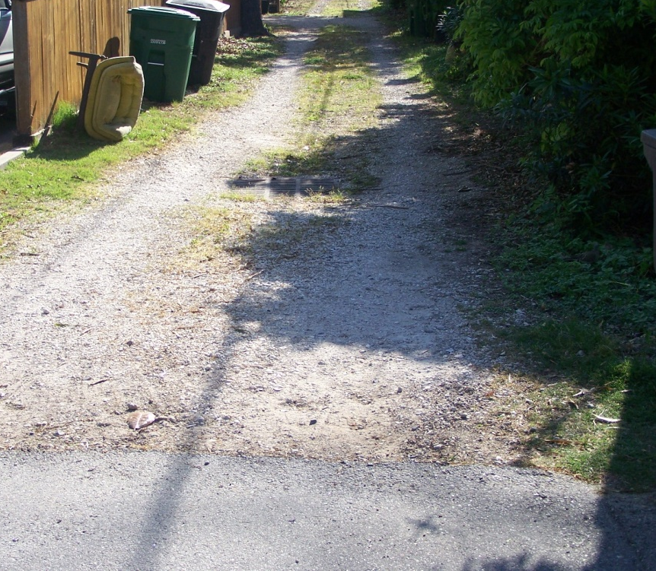
Asphalt V Section
Gravel

Slide 12
PUBLIC ALLEY PUBLIC ACCESS PERMITS
Plans (Engineered Design)
Survey
Alley Plan and Profile
Provide No Objection Letter with Plan set
Application
3300 Main, Traffic Section
Provide Plans Permits
Driveway
Sidewalk

Slide 13
PUBLIC ALLEY ALLEY IMPROVEMENT PERMIT –
611 Walker
Plans
5 Sets (24” x 36”)
Utility Approvals
Bound copies provided for Thursday walk through
Approved plans sent for signature and scanning
Pickup following Tuesday
Permits
Street Cut
Storm and Paving

Slide 14
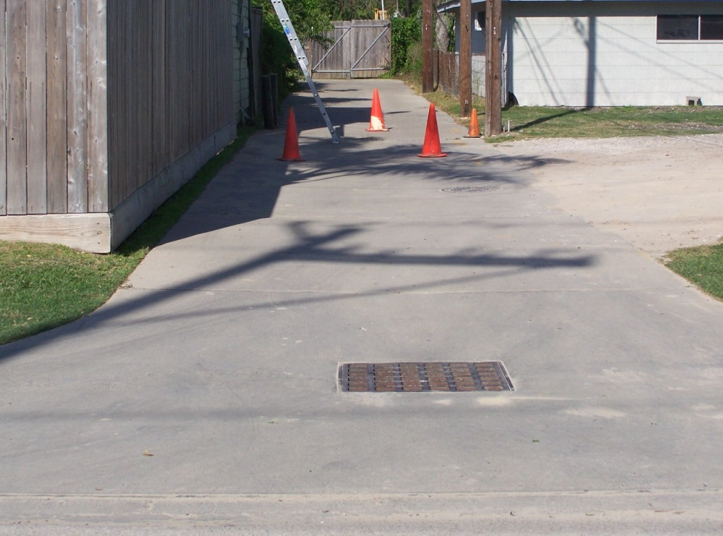
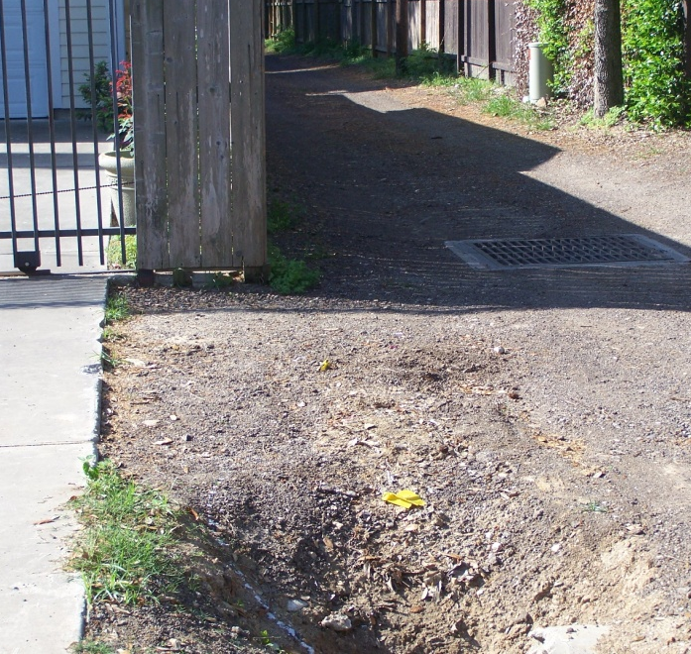
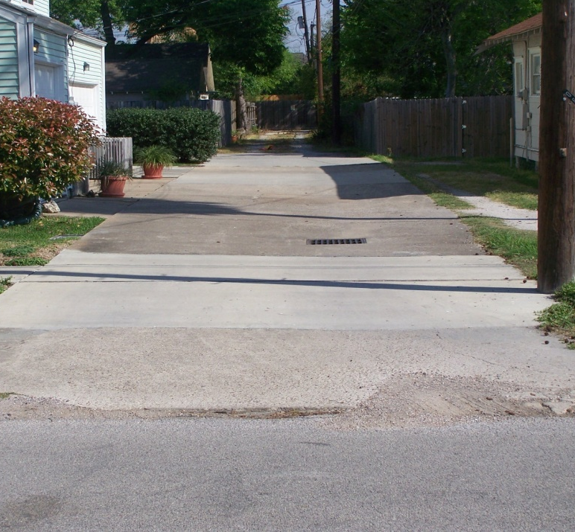
Alleys with Culvert Drainage System

Slide 15
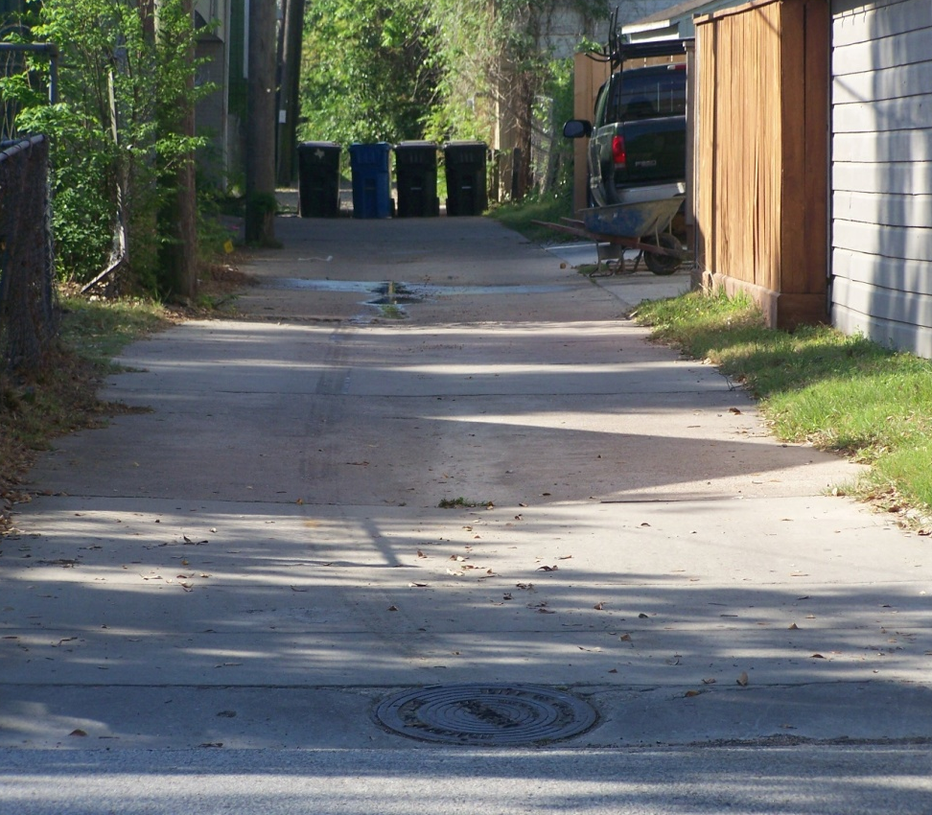
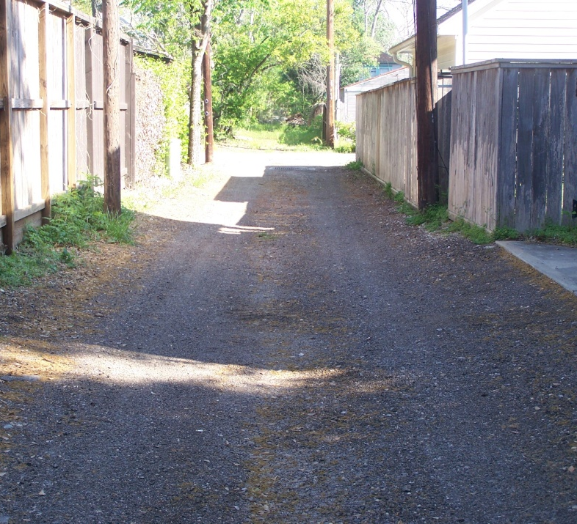
Alleys with Drainage Considerations

Slide 16
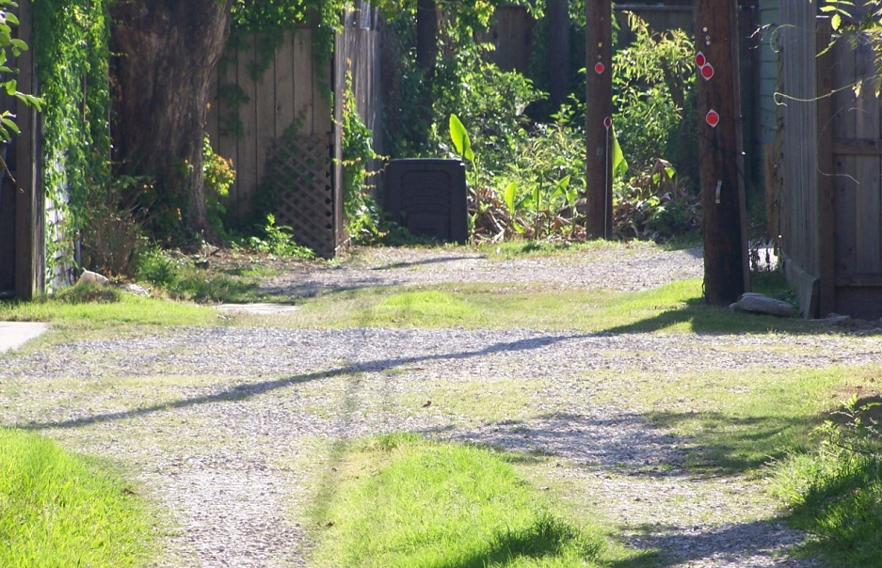
ENCROACHMENTS-VIOLATIONS
EXISTING > 1 YEAR
Property matter between Homeowners
NEW HOME CONSTRUCTION
Red Tag by Code Enforcement unless they have completed all permitting requirements
NEW < 1 YEAR
Red Tag by
Street ROW Inspectors

Slide 17
OTHER
ALLEY DRAINAGE
Is not to drain onto adjacent property
Storm water to drain along alley into drainage facilities or intersecting street.
Is not to be the primary drainage for abutting development
MAINTENANCE
City does not maintain unless constructed to street standards
City does have and maintain utilities within alleys
78 existing alleys
JOINT REFERRAL
Abandonment or sale of alley can be requested when underlying fee owner is known
Website:
http://documents.publicworks.houstontx.gov/document-center/alleys-maintained-by-the-city/index.htm

Slide 18
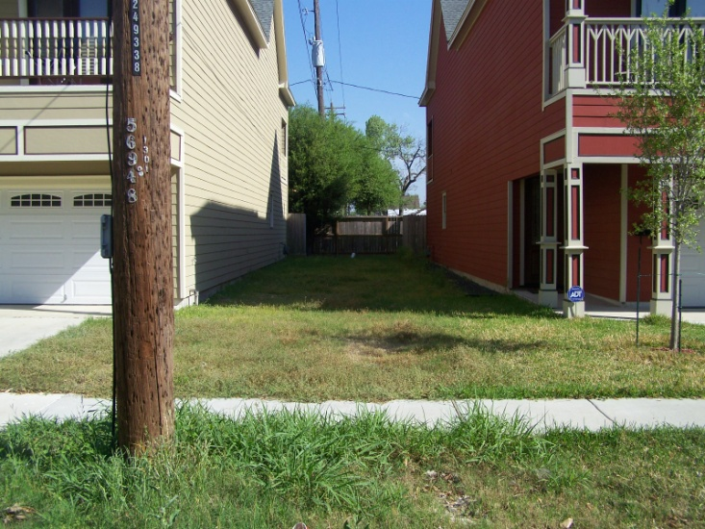
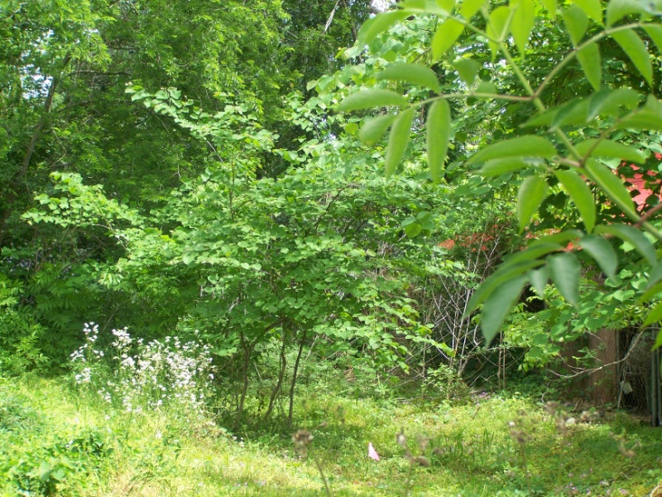
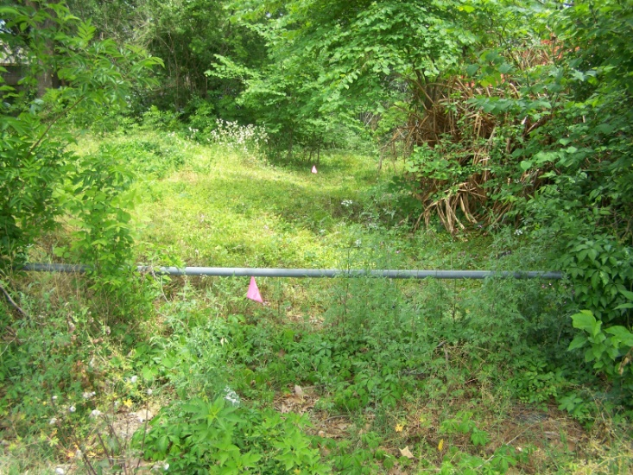
EXAMPLES
Accessible Alley
Alleys Requiring Improvement

Slide 19
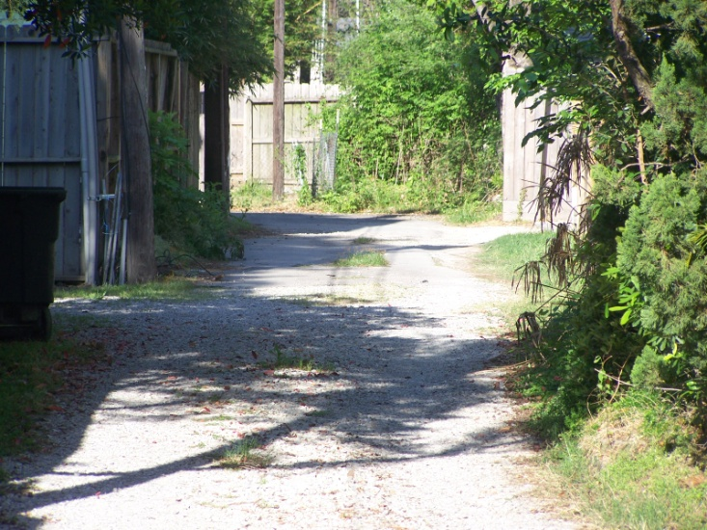
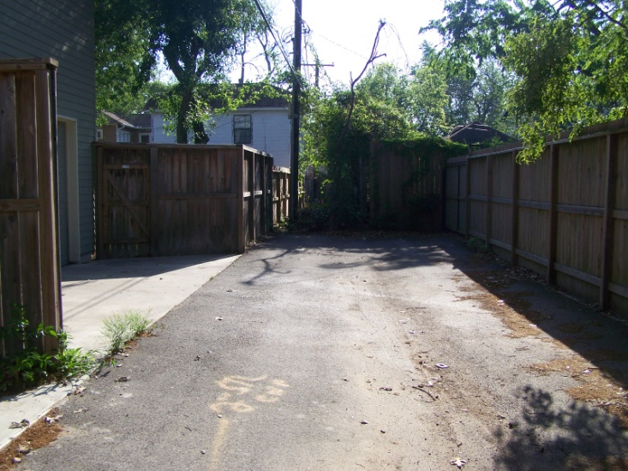
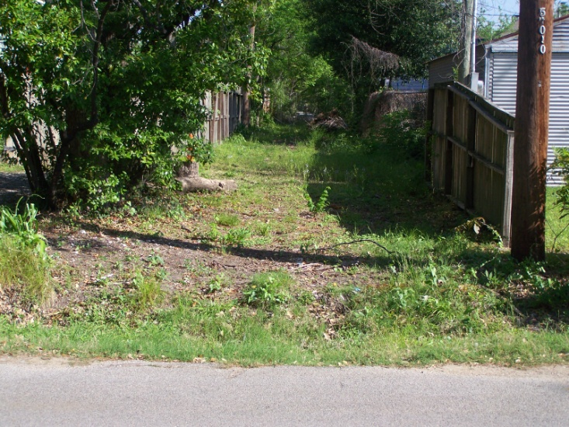
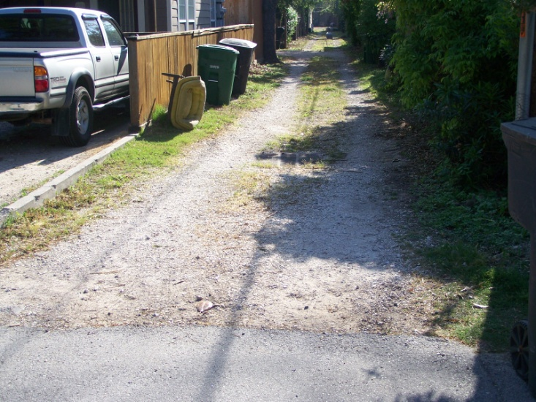

Slide 20
NEIGHBORHOOD PROTECTION Ord: 10-451(b) (10) & 10-341 © (15)
Investigates weed, debris, trash complaints
Adjacent property owners are notified of violation(s)
Lien assessed on non-compliant properties
High visibility/hazard locations cut by our Special Projects Team
Alley obstructions are referred to Structural

Slide 21
SOLID WASTE
Adopt - A- Container Program
Non-profit organizations
May request large bulk containers for weekend neighborhood cleanup campaigns.
Requests must be sent to the SWMD in writing at least 14 days prior to the anticipated cleanup date.
Bulk Containers are provided on a “first come, first serve” basis
Containers are delivered on Friday and collected on Monday.
Only non-profit organizations and civic organizations coordinating a neighborhood cleanup campaign are eligible to sponsor bulk containers.
For more information, call 3-1-1.

Slide 22
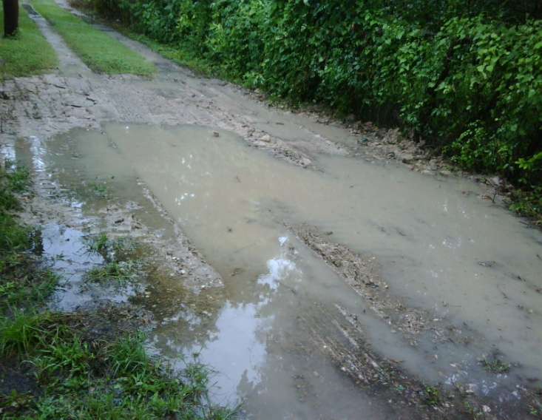
MOST COMMON
MISTAKES AND COMPLAINTS
Illegal Construction
Working without a permit in City ROW
Drainage
Muddy and rutted alley
Water flow or standing water
Encroachments
Buildings into alley
Fences into or across alley
Landscaping
Trees
Maintenance of alley vegetation

Slide 23
CONTACTS
Office of City Engineer Richard Smith 832-394-9137 Lagnesh Varshney 832-394-9100
Note:
Effective June 2011, Code Enforcement and Office of City Engineer will be located at:
Houston Permitting Center: 1002 Washington Ave.

